Slide 1

DP-201T06: Designing for Efficiency and Operations

Slide 2
Lesson Objectives
Maximize efficiency of cloud spend
Use Monitoring and Analytics to gain Operational Insights
Use Automation to reduce effort and errors

Slide 3
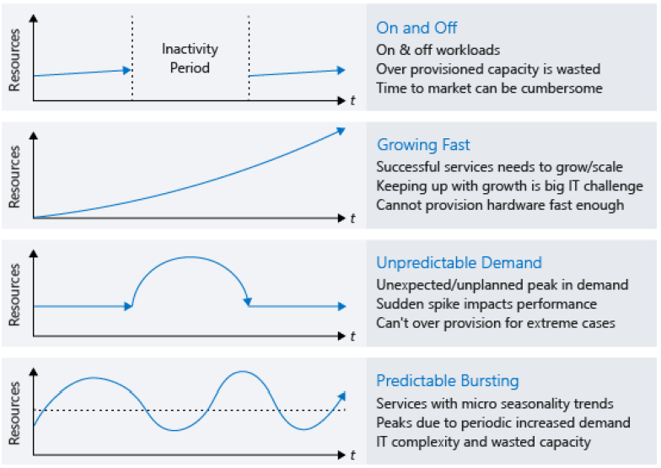
Maximize your Cloud Spend

Slide 4

Maximize your Cloud Spend
How the cloud changes your expenses
Track your cloud spend
Organize to optimize
Optimizing IaaS costs – Azure Advisor
Compute
Right size virtual machines
Implement shutdown schedules for virtual machines
Apply compute cost discounts
Virtual machine disk storage cost optimization (std vs premium)
Optimizing PaaS costs
Optimizing Azure SQL Database costs
Optimizing Blob storage costs
Leverage consumption pricing models
Pause Compute Operations
Notes:
Organize to optimize
From a billing perspective, resources can be easily grouped by:
Assigning resources to different subscriptions.
Assigning resources to different resource groups.
Applying tags to resources.
Using subscriptions and resource groups to organize resources is an easy way to logically group resources and can be leveraged when going through billing data. Tags come into play when resource relationships span the boundaries of subscriptions and resource groups
Compute
There are different options available to achieve cost savings for virtual machines.
Choose a smaller virtual machine instance size.
Reduce the number of hours a virtual machine runs.
Use discounts for the compute costs (Azure Hybrid Benefit – SQL & VM ) / Reserved Instances
Implement shutdown schedules for virtual machines
You can use Azure Automation to run your VMs only during those times that your workloads require.
You can use the auto-shutdown feature on a virtual machine to schedule a one-off automated shutdown.
Finally, you can stop a VM manually in the Azure portal
Optimizing Blob storage costs
Hot access tier - Highest storage costs but the lowest access costs.
Cool access tier - Lower storage costs and higher access costs compared to hot storage. This tier is intended for data that will stay in the cool tier for at least 30 days.
Archive access tier - Lowest storage cost and highest data retrieval costs compared to hot and cool storage. This tier is intended for data that can tolerate several hours of retrieval latency and will stay in the archive tier for at least 180 days.

Slide 5
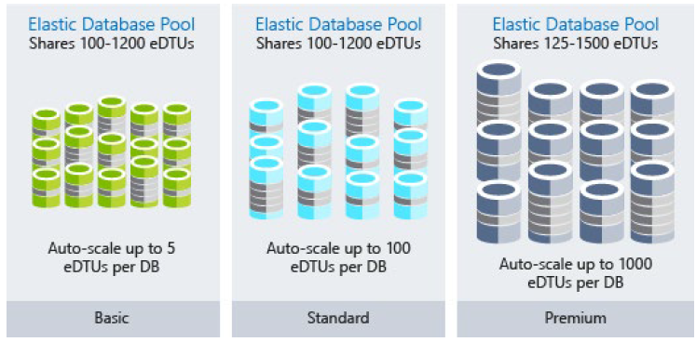
Optimizing Azure SQL Database Costs
DTU vs vCores Model
If your database has unpredictable bursts or spikes in activity?
Elastic pools can reduce costs for unpredictable workloads.

Slide 6
Database Dynamic Scaling
Azure SQL Database
With a single database, you can use either DTU or vCore models to define maximum amount of resources that will be assigned to each database.
Elastic pools enable you to define maximum resource limit per group of databases in the pool.
Azure SQL Managed Instance
SQL Managed Instance uses vCores mode and enables you to define maximum CPU cores and maximum of storage allocated to your instance.
All databases within the managed instance will share the resources allocated to the instance.
https://azure.microsoft.com/en-us/resources/videos/azure-sql-database-dynamically-scale-up-or-scale-down/

Slide 7
Alternative scale methods
Read scale-out is an available feature where you are getting one read-only replica of your data where you can execute demanding read-only queries such as reports.
A read-only replica will handle your read-only workload without affecting resource usage on your primary database.
Database sharding is a set of techniques that enables you to split your data into several databases and scale them independently.
https://docs.microsoft.com/en-us/azure/azure-sql/database/elastic-scale-introduction

Slide 8
Leverage Consumption Pricing Models
Moving to Serverless: Azure Functions
Moving to PaaS services into a true consumption pricing model.
Instances of the Azure Functions host are dynamically added and removed based on the number of incoming events.
This serverless plan scales automatically, and you're charged for compute resources only when your functions are running.
On a Consumption plan, a function execution times out after a configurable period of time.
Billing is based on number of executions, execution time, and memory used. Billing is aggregated across all functions within a function app.

Slide 9
Monitoring and Analytics to gain Operational Insights
Monitoring is the act of collecting and analyzing data to determine the performance, health, and availability of your business application and the resources that it depends on.
Core Monitoring
Deep infrastructure monitoring
Deep application
monitoring
Core monitoring provides fundamental, required monitoring across Azure resources and gives you visibility into four key core monitoring areas:
Activity logging
Health of cloud services
Metrics and diagnostics
Recommendations on best practices
For typical IaaS workloads, there's more metrics and diagnostic information to gather from the network or operating systems. Pulling information from SQL Server to ensure it's properly configured, to analyzing free disk space across all the servers in your environment are all examples where Log Analytics can provide deep insights.
You can take your monitoring capabilities even further by looking deep into your applications to identify performance issues, usage trends, and overall availability of services. By using an application performance management tool, you can better detect and diagnose issues that occur within your web apps and services.

Slide 10
Automation to Reduce Effort and Error
Managing the infrastructure of any type of workload involves configuration tasks. This configuration can be done manually, but it can be labor-intensive, error prone, and inefficient.
Infrastructure as code DevOps
Infrastructure as code is the management of infrastructure (networks, virtual machines, load balancers, etc) in a descriptive model, using a versioning system like what is used for source code. there are two different approaches you can take: imperative (Azure CLI or Azure PowerShell ) and declarative automation (Resource Manager templates).
Automation of
operational tasks
There are ongoing operational activities that can also be automated. Automating these tasks with Azure Automation reduces manual workloads, enables configuration and update management of compute resources, and centralizes shared resources such as schedules, credentials, and certificates.
Automating development environments
At the other end of the pipeline of your cloud infrastructure are the development machines used by developers to write the applications and services that are the core of your business. You can use Azure DevTest Labs to stamp out VMs with all the correct tools and repositories that they need.
Notes:
With imperative automation, we're specifying how things are to be done. This is typically done programmatically through a scripting language or SDK. For Azure resources, we could use the Azure CLI or Azure PowerShell

Slide 11
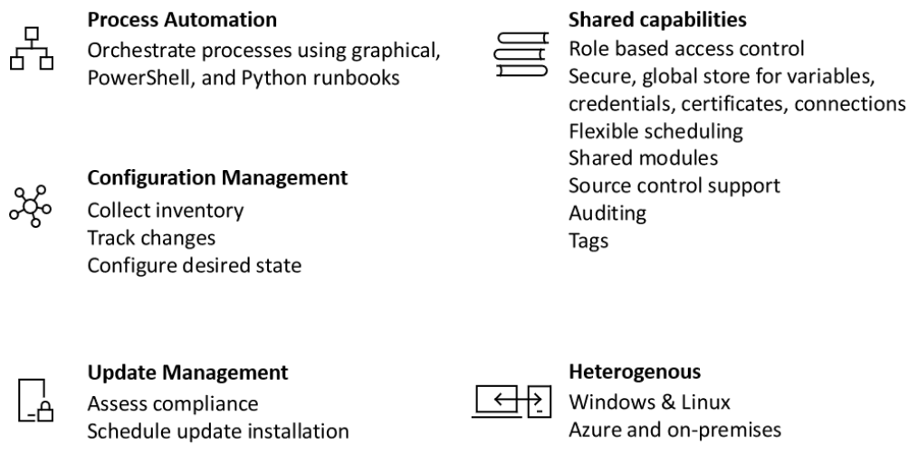
Azure Automation
https://docs.microsoft.com/en-us/azure/automation/
https://azure.microsoft.com/en-us/blog/azure-automation-runbook-management/

Slide 12

Lab: Designing for Efficiency and Operations

Slide 13
Lab overview
The students will explore way in which they can maximise the efficiency of using a cloud environment and how they can monitor and analyze operational efficiencies from the Azure portal. They will also look at how automation can be used to reduce effort and error.
Lab objectives
After completing this lab, you will be able to:
1. Maximize the Efficiency of your Cloud Environment
2. Use Monitoring and Analytics to Gain Operational Insights
3. Use Automation to Reduce Effort and Error

Slide 14
Lab scenario
You have recently been hired as a senior data engineer at AdventureWorks and are working on building a cloud data platform solution that meets the organizations technical and business requirements.
The Chief Financial Officer (CFO) has expressed concerns that she does not want the costs of running the infrastructure to “spiral out of control”. She would like assurances that the information services team are operating the supporting services as efficiently as possible and she would like to know what steps are being taken to get information that provides evidence of how the environment is being used.
In addition, the CIO wants to gain an understanding how the team can monitor the systems and work efficiently through automation and would like an overview of what can be done to ensure that administrative effort can be reduced through automation.
At the end of this lab, you will have:
1. Maximize the Efficiency of your Cloud Environment
2. Use Monitoring and Analytics to Gain Operational Insights
3. Use Automation to Reduce Effort and Error

Slide 15
Lab review
Exercise 1 – Are there aspects of the Price Calculator that would be helpful?
Exercise 2 – Was there any debate in the monitoring technologies chosen?
Exercise 3 – Are there any additional tasks that you think a Data Engineer should perform?

Slide 16
Lab 6 – Designing for Efficiency and Operations
Exercise 1 - Task 1: Maximize the Efficiency of your Cloud Environment.
# | Best practise | Service
1 | Use SQL Database Elastic Pools to dynamically scale to optimizes performance and cost | SQL Database
2 | Scale up Data Warehouse Units (DWU) when loading data, scale down once the loading is complete. | Azure Synapse
3 | Right size Data Service usage. i.e Use the correct DTUs, DWUs, RTUa etc | SQL Database Azure Synapse Cosmos DB
4 | Pause Azure SQL DWU compute operations when the data warehouse is not in use. | Azure Synapse
5 | Use Azure Blob Storage for data that is not queried, such as Archive Data | Azure Blob Store
6 | Use Data Lake Store Gen II for data that is to be queried | Data Lake Store Gen II
7 | Use partitioning to spread data across all the distributed storage as evenly as possible | Cosmos DB Azure Synapse
8 | Minimize the use of multiple write regions to meet business requirements while minimizing costs | Cosmos DB
9 | Modify Streaming units to account for data volumes, query complexity and latency for streaming data | Stream Analytics
https://azure.microsoft.com/en-gb/pricing/calculator

Slide 17
Lab 6 – Designing for Efficiency and Operations
Exercise 2 - Task 1: Use Monitoring and Analytics to Gain Operational Insights.
# | Monitoring Type | Technology | Justification
1 | Core Monitoring | Azure Monitor | The core monitoring of the Azure platform to be provided by Azure Monitor. You can get at-a-glance reporting on the health and performance of all your cloud resources, from virtual machines to applications to individual lines of codes in the applications. You can also use this as the basis for establishing baselines for the services within Azure.
2 | Core Monitoring | Azure Service Health | This is the best place to look for service impacting communications about outages, planned maintenance activities, and other health advisories
3 | Deep Infrastructure Monitoring | Log Analytics | Enables you to perform in-depth analysis of specific services within Azure. Use Log Analytics in the Azure portal to write log queries and interactively analyze log data using the powerful Data Explorer analysis engine. It is also integrated into Azure Monitor.
4 | Deep Application Monitoring | Application Insights | You can use this to monitor applications and its usage. It enables developers and data engineers to understand application usage patterns. It is also integrated into Azure Monitor.

Slide 18
Lab 6 – Designing for Efficiency and Operations
Exercise 3 - Task 1: Use Automation to Reduce Effort and Error.
# | Automation methods
1 | Azure CLI
2 | PowerShell
3 | Azure Resource Manager Templates
What is the difference between imperative and declarative automation?
With imperative automation, we're specifying how things are to be done. This is typically done programmatically through a scripting language or SDK. For Azure resources, we could use the Azure CLI or Azure PowerShell.
With declarative automation, we're specifying what we want our result to be, leaving the details of how it's done to the system we're using. On Azure, declarative automation is done through the use of Azure Resource Manager templates.

Slide 19

Next steps
Module Summary
In this module, you have learned about:
- Maximize efficiency of cloud spend
- Use Monitoring and Analytics to gain Operational Insights
- Use Automation to reduce effort and errors
After the course, consider watching this video that introduces Azure DevOps and how you can use it to bring about operational efficiencies.

